Slide 1

Structural Wind Engineering Bank of America Plaza, Atlanta
GROUP 6:
Javad Mohebi
Rodrigo Castedo-Hernández
Raúl San Miguel Peñas
Supervisor: Anoop Kodakkal
March 2, 2023

Slide 2

Agenda
Structural, Terrain, and Wind Information
Summary of Eurocode-based Calculations
Geometry Simplifications
GiD and Kratos Model Setup
Simulation 1 Results
Simulation 2 Results
Conclusions
APPENDIX

Slide 3
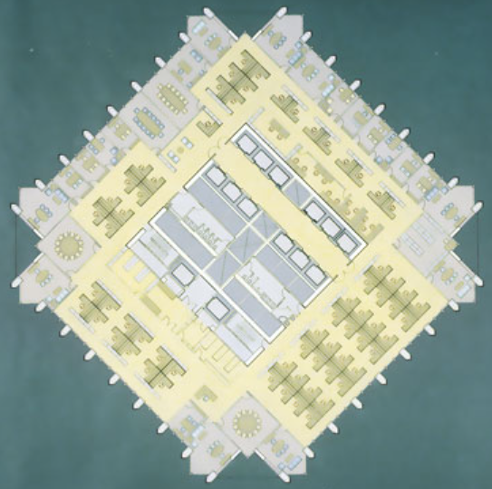
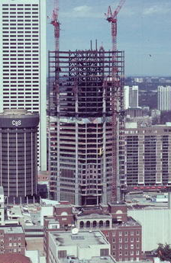
The Structure
Height: 311.8 m
Base: 50x50 m
Floors: 55
Core-shear wall structure
Material: Concrete-Steel Composite
Material/structural properties from CYK4 (based on benchmark case by the CAARC)
Year completed: 1992

Slide 4
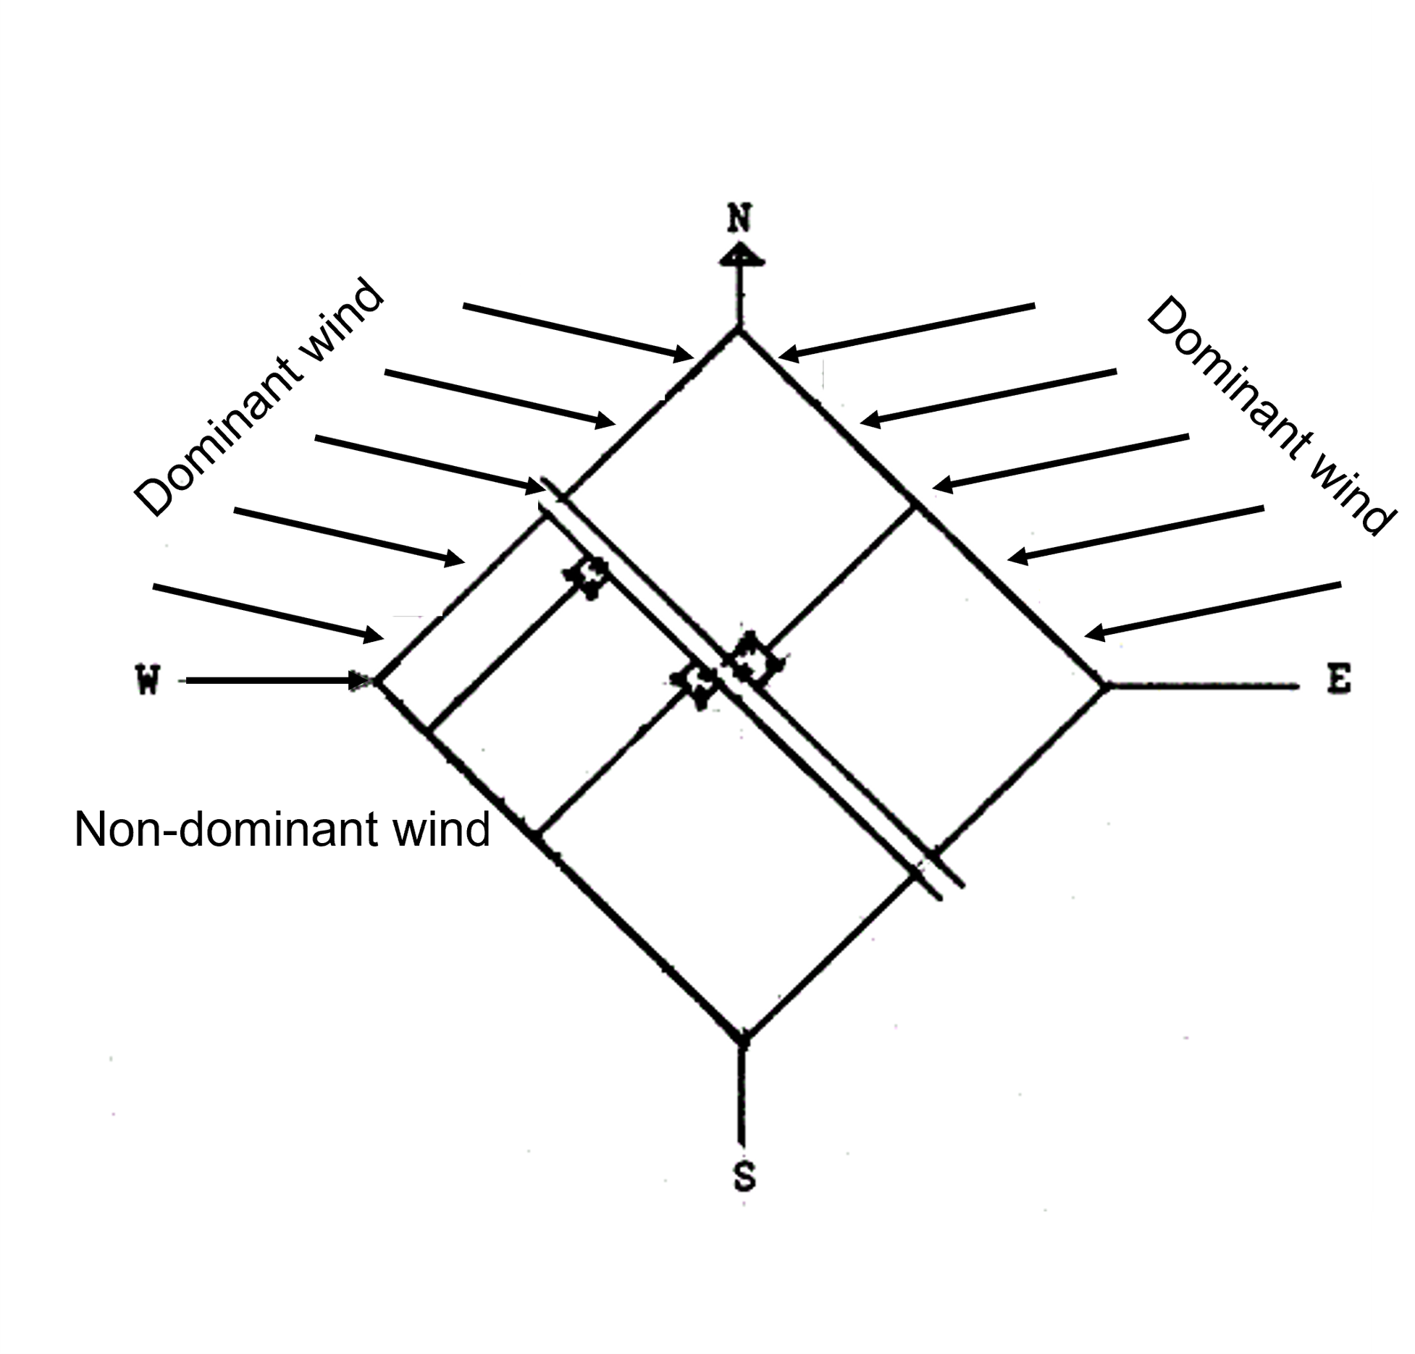
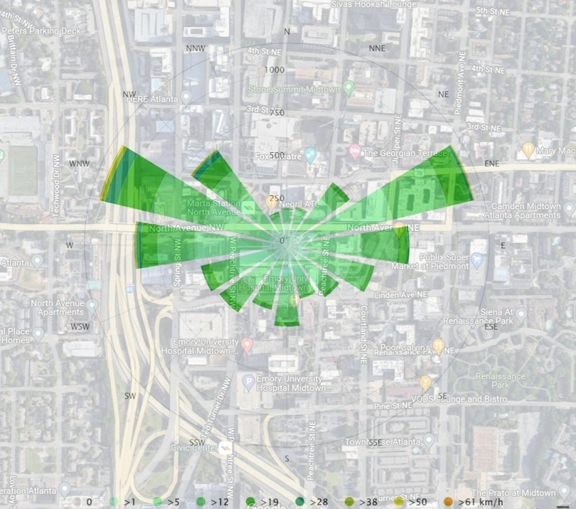
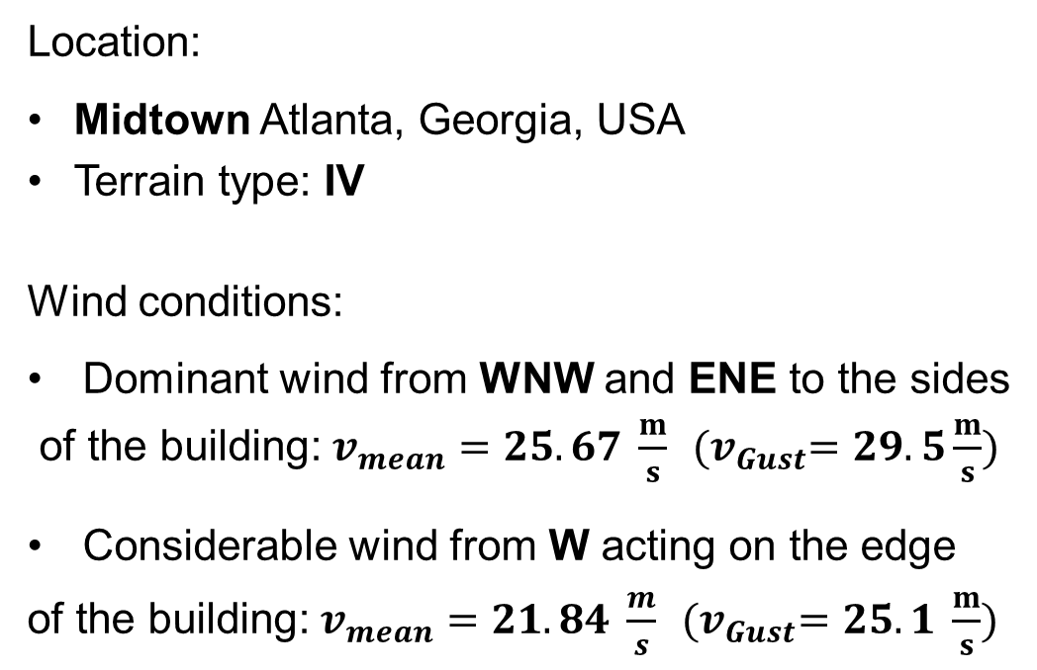
Location and wind conditions
Location:
Midtown Atlanta, Georgia, USA
Terrain type: IV
Wind conditions:
Dominant wind from WNW and ENE to the sides
of the building: $v_{mean}=25.67 \frac{m}{s}$ ${(v}_{Gust}=29.5\frac{m}{s})$
Considerable wind from W acting on the edge
of the building: $v_{mean}=21.84 \frac{m}{s}$ ${(v}_{Gust}=25.1 \frac{m}{s})$

Slide 5
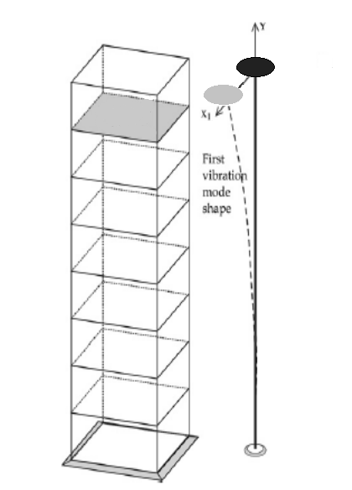
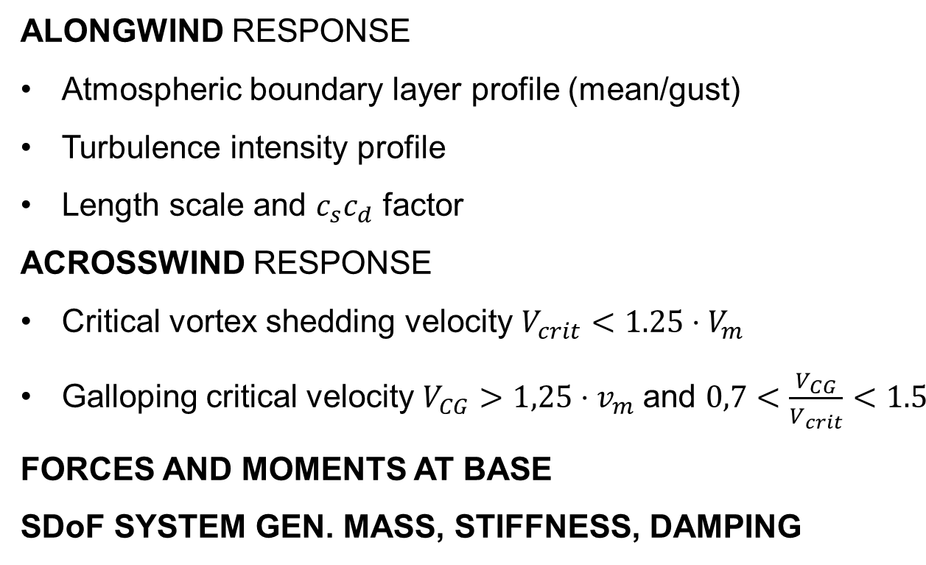
Eurocode-based Calculations
ALONGWIND RESPONSE
Atmospheric boundary layer profile (mean/gust)
Turbulence intensity profile
Length scale and $c_{s}c_{d}$ factor
ACROSSWIND RESPONSE
Critical vortex shedding velocity $V_{crit}<1.25⋅V_{m}$
Galloping critical velocity $V_{CG}>1,25⋅v_{m}$ and $0,7<\frac{V_{CG}}{V_{crit}}<1.5$
FORCES AND MOMENTS AT BASE
SDoF SYSTEM GEN. MASS, STIFFNESS, DAMPING
Simplified structure

Slide 6
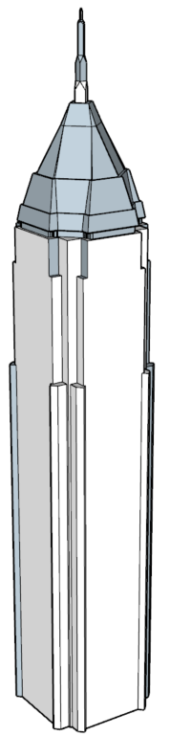
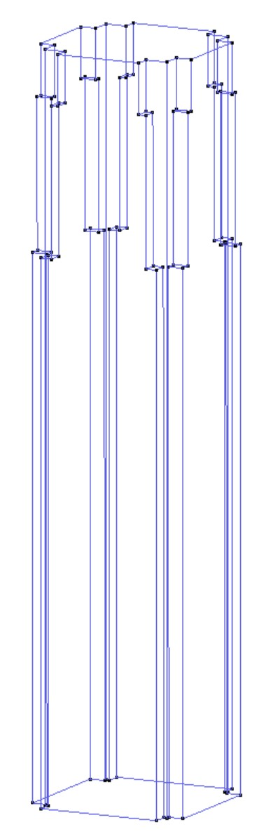
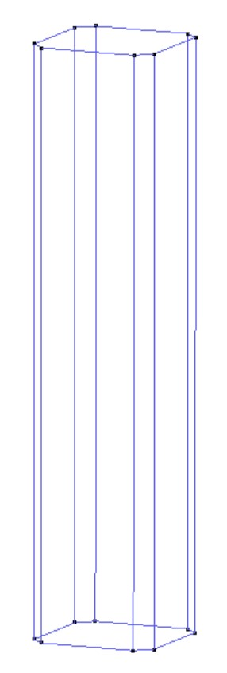
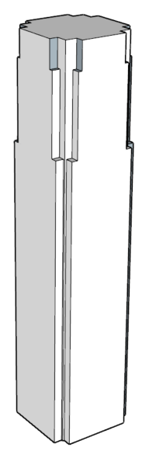
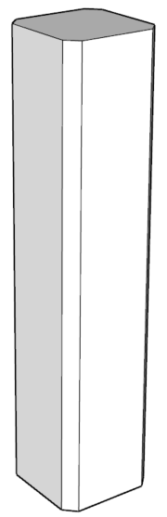
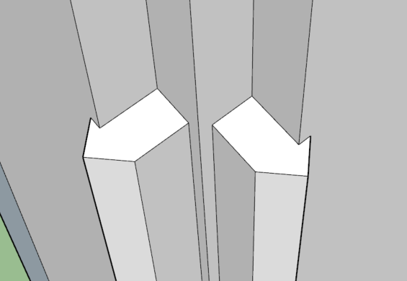
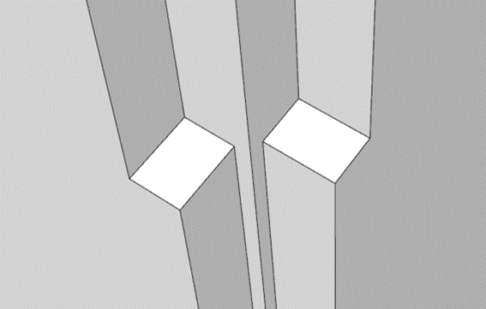
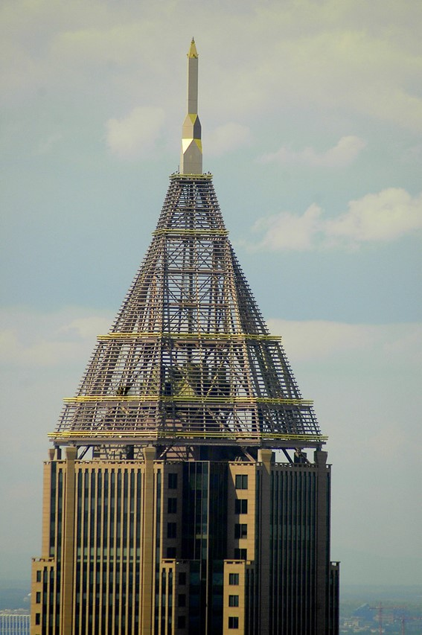
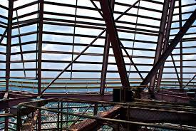


Geometry
Difficult to get the exact dimensions of the building
Model obtained from 3D Warehouse
Model scaled based on the height
Simplifications made
.ifc format

Slide 7
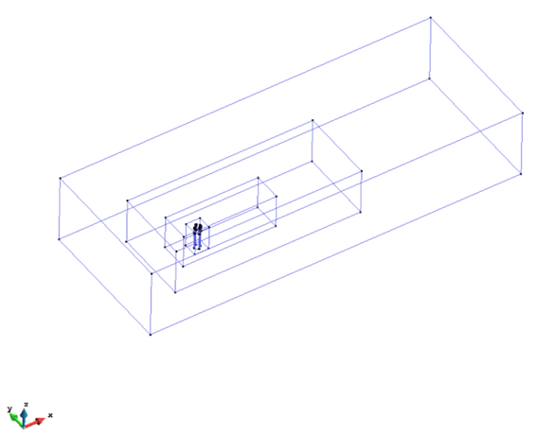
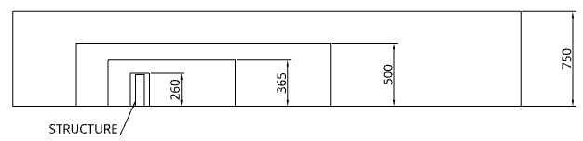
Simulation (Subdomains)
Subdomain boxes
500
750
1500
3000 (12H)
1000
250
500
1500 (6H)
1000 (4H)

Slide 8
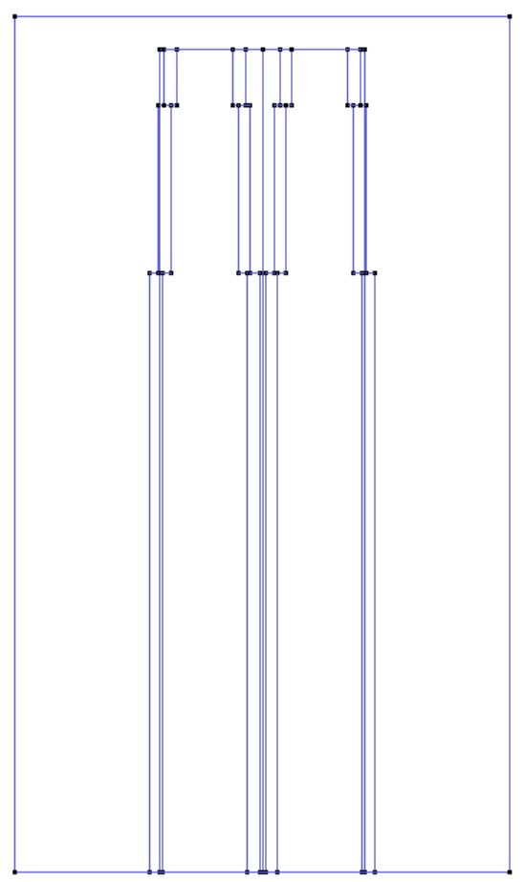
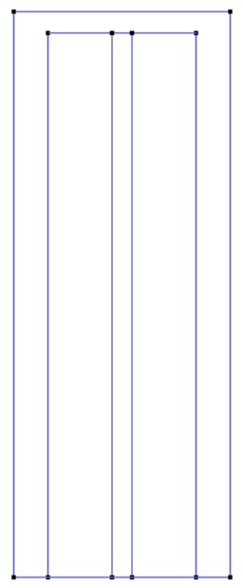
Simulation (Subdomains)
Subdomain boxes
250
260
150
100

Slide 9
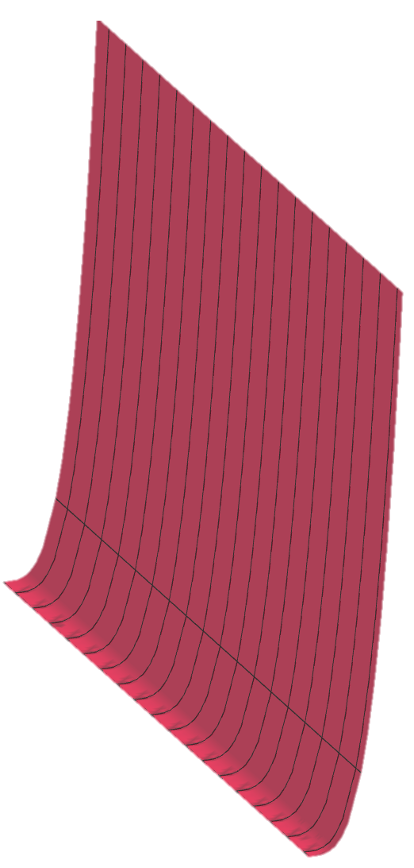
OUTLET.
ATMOSFERIC PRESSURE
Simulation (Boundary Conditions)
WALL & TOP. SLIP CONDITION
GROUND & STRUCTURE. NON SLIP CONDITION
WALL & TOP. SLIP CONDITION
INLET. CUSTOM VELOCITY

Slide 10
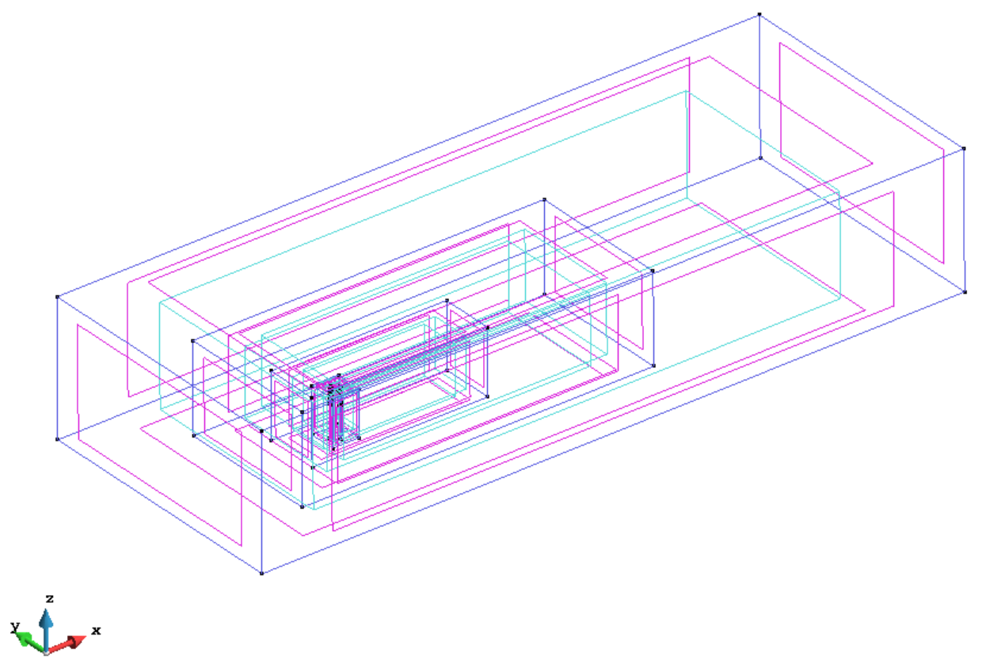
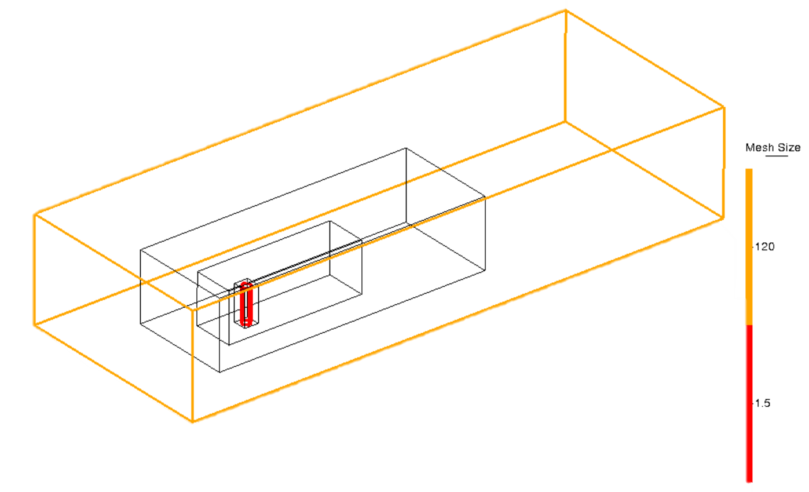
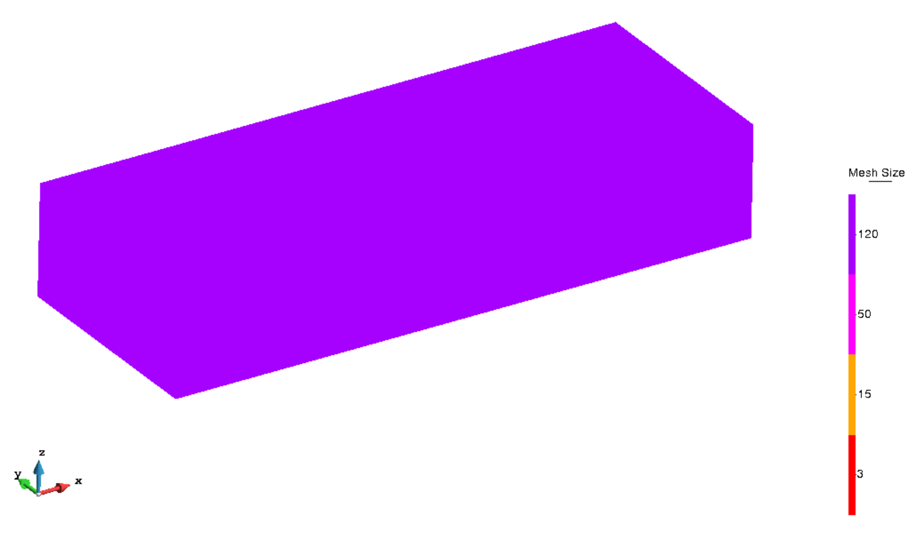



Simulation (Mesh)
Mesh size
120
Lines
1.5
120
 | Mesh quality
 | Simulation 1 |  | Simulation 2
Triangular | 4.54E4 | (>50º) | 4.25E4 | (>50º)
Tetrahedral | 2.90E6 | (>55º) | 2,48E6 | (45º-55º)
50
15
Surfaces and Volumes
3|2

Slide 11
Simulation (Kratos)
Time parameters
Time step = 0.03s
Total time = 250s
Time intervals
Ramp up (0,10)
Constant Flow (10, 250)
Mathematical model
Incompressible N-S eq.
Time integration Scheme
Second Order Backward Differentiation
Formula (BDF2)
Turbulence model
LES
One way coupling

Slide 12
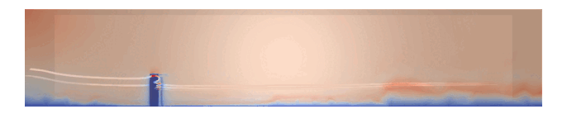

Simulation 1
Flow deformation after hit
Velocity decrease behind the building
Vortex shedding behind the building
Velocity increases at the edges
Velocity lines in Paraview
Velocity streamlines from Paraview

Slide 13
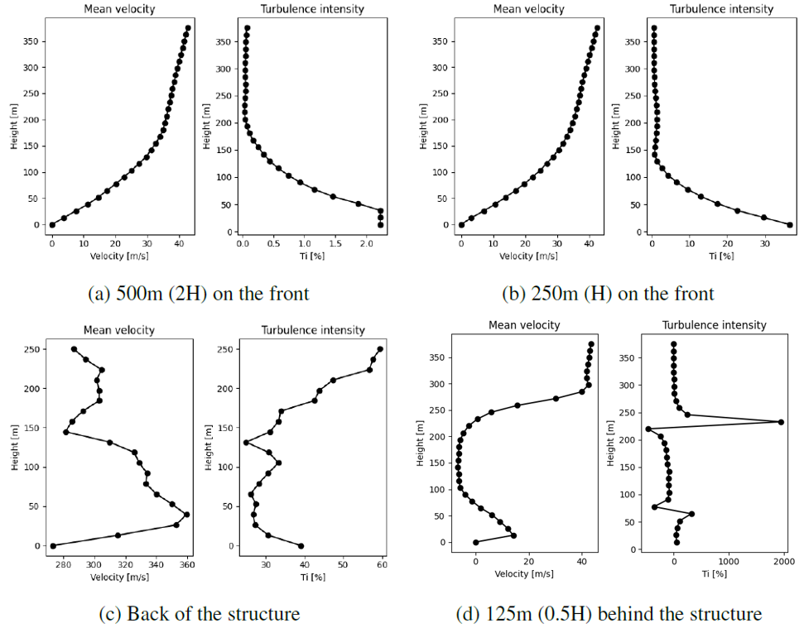
Simulation 1
No influence at H and 2H in front
0 velocity at 0 height due to no-slip BC
Turbulence behind the building
Deformed wind profile behind
Fig. 3: Mean velocities and turbulence intensities

Slide 14
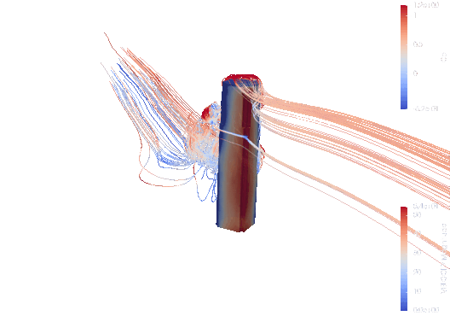
Simulation 1
Increase wind pressure at the edge
Focused on the upper part of the edge
Under pressure region at the back
Gradient pressure decrease on the sides
Velocity streamlines from Paraview

Slide 15
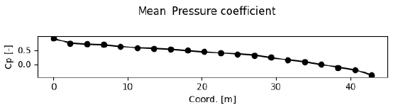
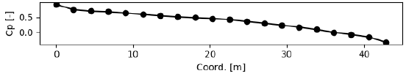
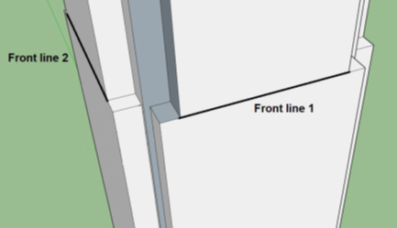
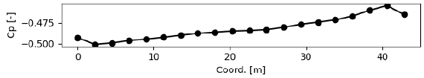
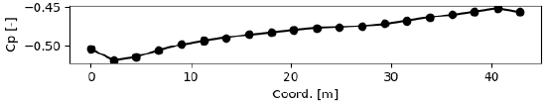
Simulation 1
Line 1
Line 2
Line 3
Line 4
4 assessment lines on the building at the height of 0.6H
Pressure assessment lines locations.
Mean pressure coefficients

Slide 16

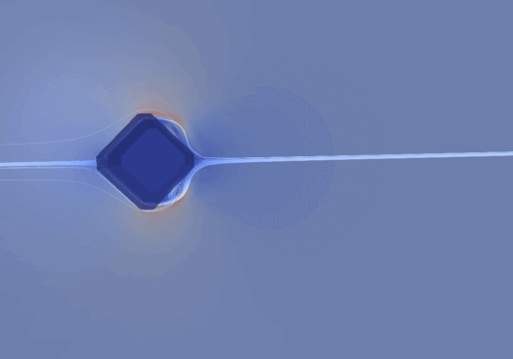
Simulation 2
Simplified geometry
Generally same behavior
Less turbulence at the back
Velocity lines in Paraview
Velocity streamlines from Paraview

Slide 17
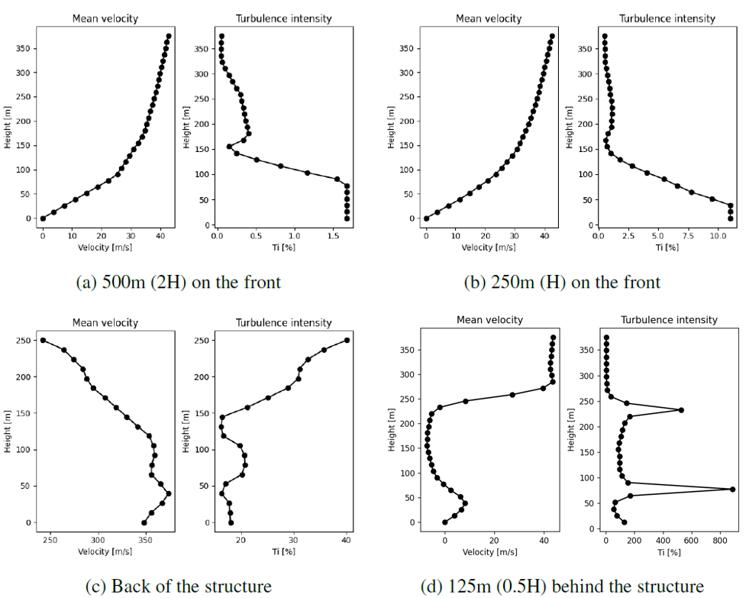
Simulation 2
Simplified geometry
Generally same behavior
Less turbulence at the back
Mean velocities and turbulence intensities

Slide 18
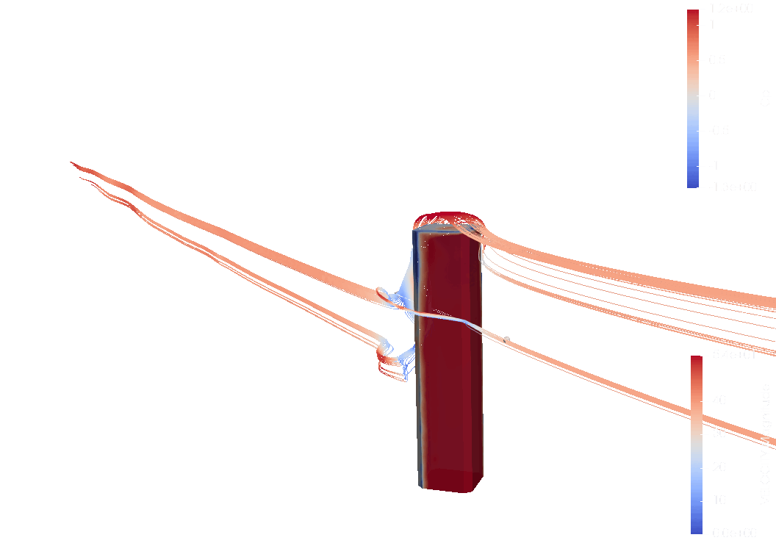
Simulation 2
Generally same behavior
No focus on the upper part of the edge due to simplified geometry
Velocity streamlines from Paraview

Slide 19
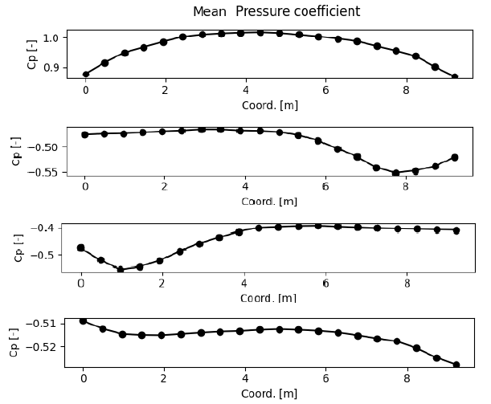
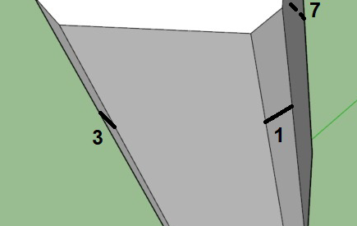
Simulation 2
Line 1
Line 3
Line 7
Line 5
4 assessment lines on the building at the height of 0.6H
Pressure assessment lines locations.
Mean pressure coefficients

Slide 20
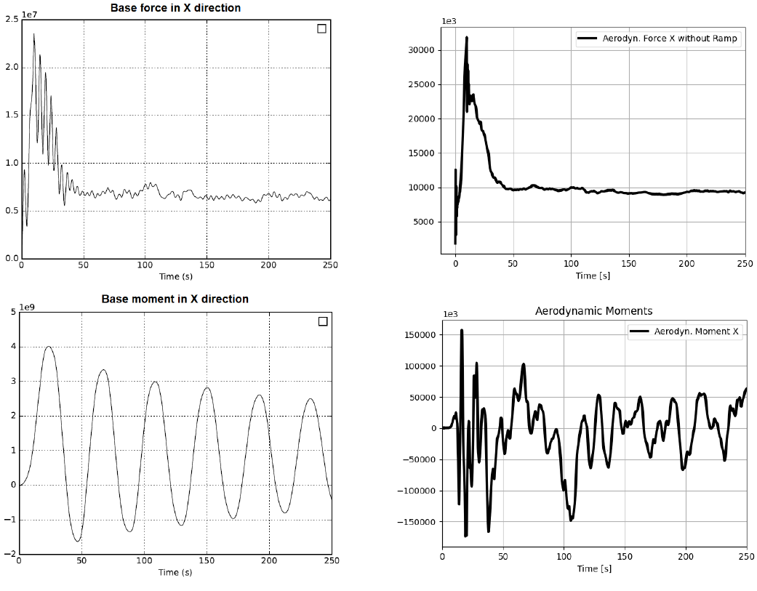
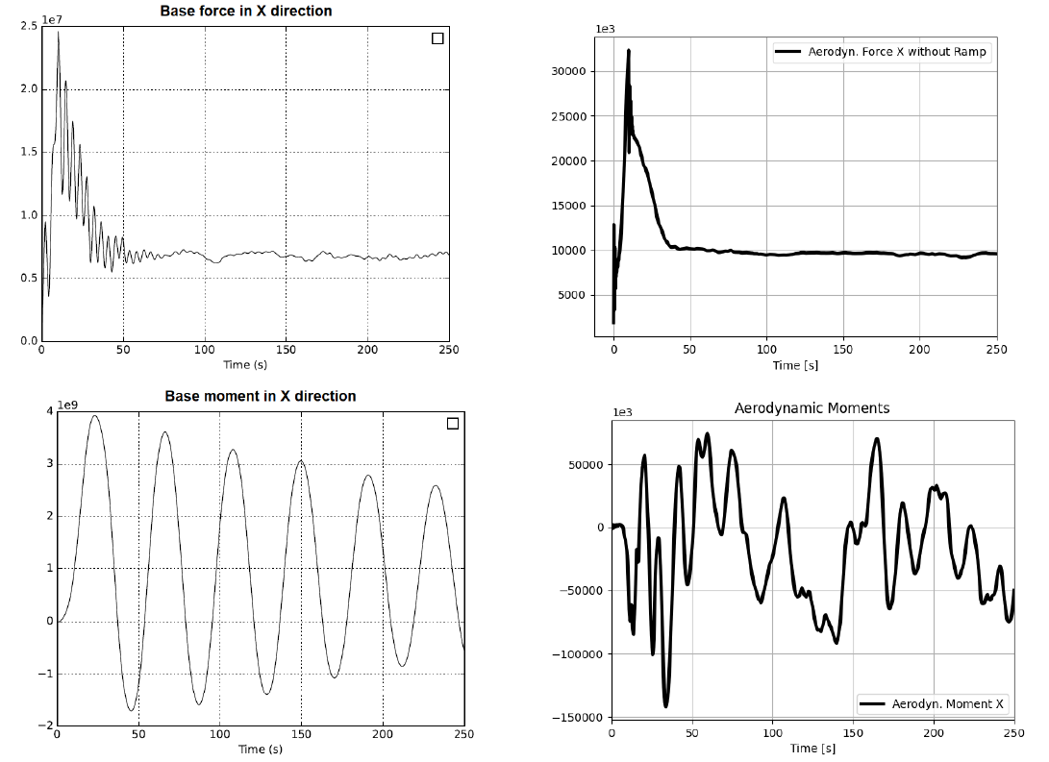
Base forces and moments analysis
Forces and moments in x-direction simulation 1.
Forces and moments in x-direction simulation 2.

Slide 21
Conclusions
Wind behavior around the Bank of America Plaza has been studied using:
Eurocode-based analysis
Two CFD simulations
The effect of the building shape has been studied using:
Wind pressure
Velocity speed and deformation
Base forces and moments

Slide 22
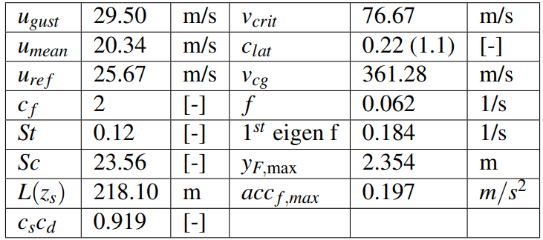
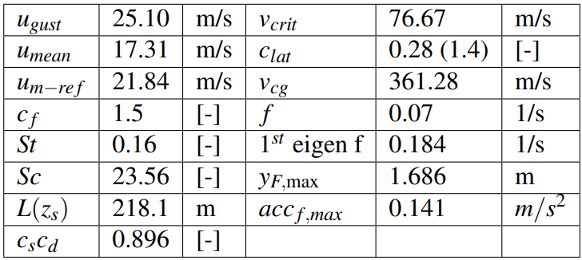
APPENDIX: Eurocode Values: WNW/ENE and W
Table 1: Eurocode values for dominant direction: WNW / ENE
Table 2: Eurocode values for non-dominant direction: W

Slide 23
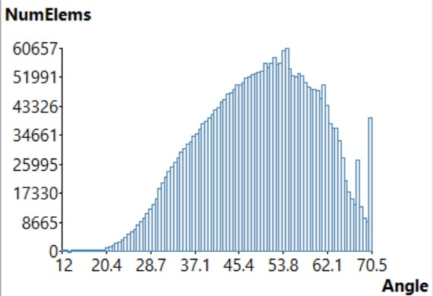
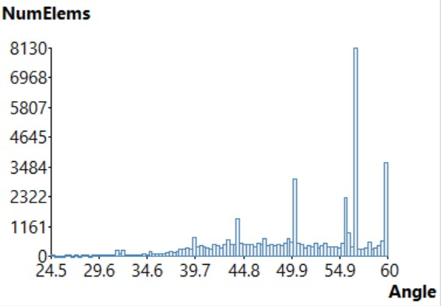
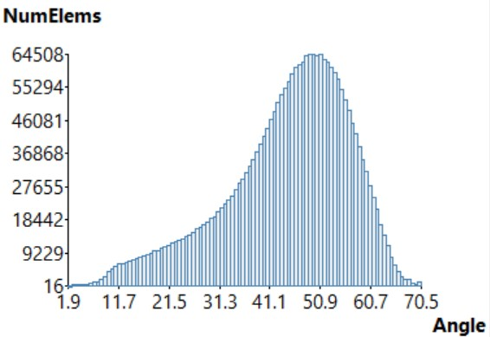
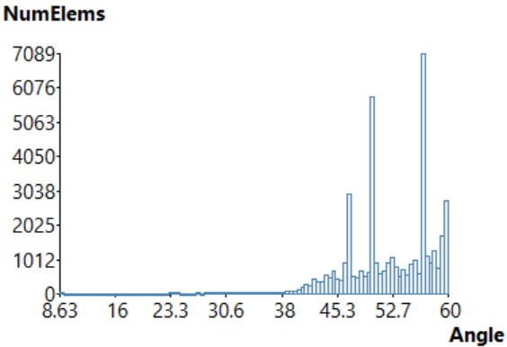
APPENDIX: Mesh quality
Simulation 1
Simulation 2

Slide 24
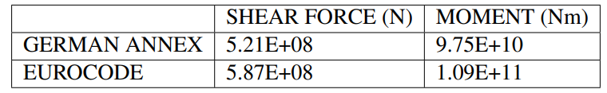
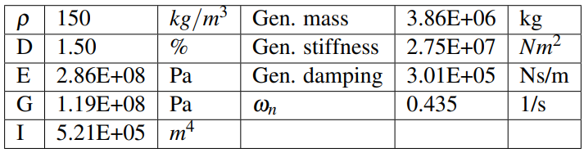
APPENDIX: Loads at Base and SDoF Model
Table 3: Shear force and bending moment at base of building due to dominant wind according to codes
Table 4: Generalized values for SDoF representation

Slide 25
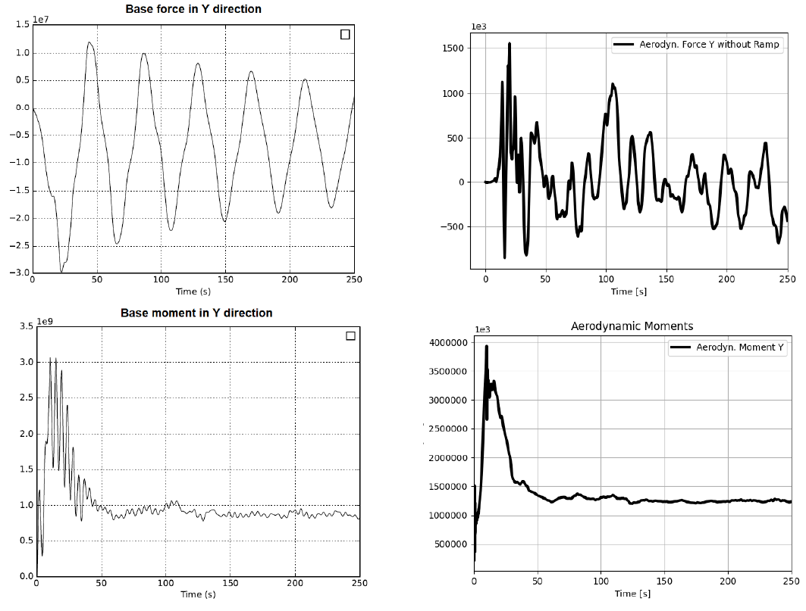
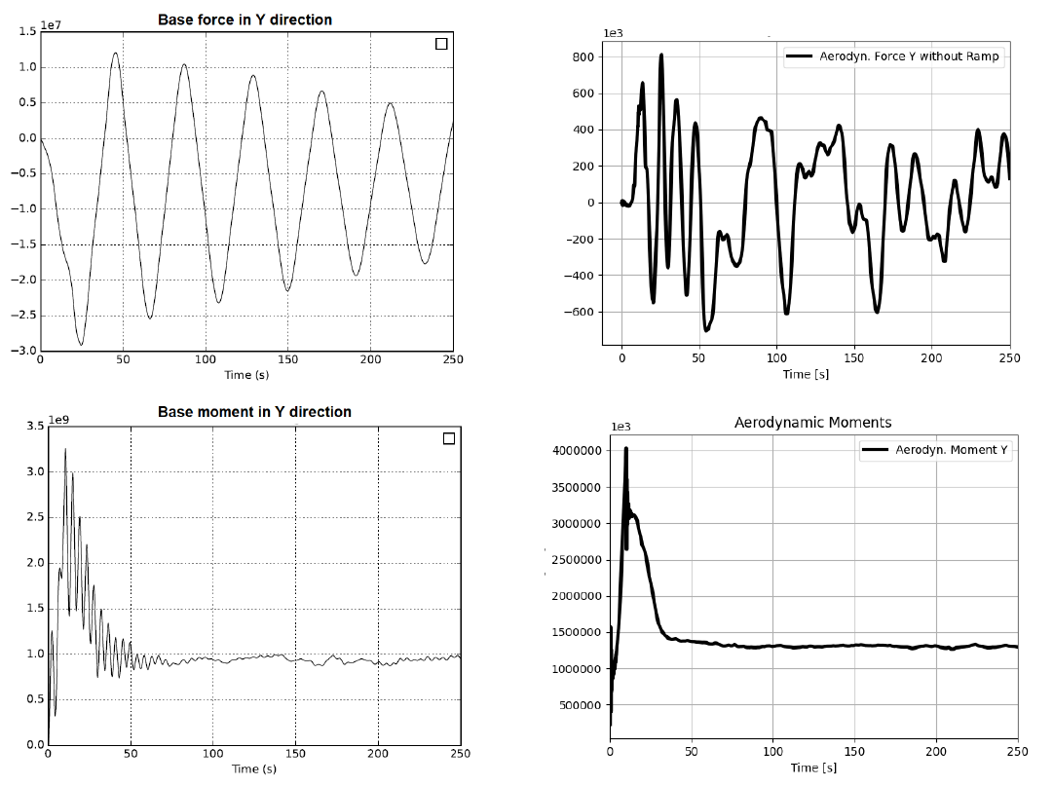
APPENDIX: Base forces and moments analysis
Figure: Forces and moments in y-direction simulation 1.
Figure: Forces and moments in y-direction simulation 2.

